Slide 1
Evaluation of Performance of Deep Learning Models
By Aymen Tariq

Slide 2
Performance Evaluation
Helps in knowing how well a machine learning model can perform on a given dataset
How well the model generalizes on unseen data

Slide 3
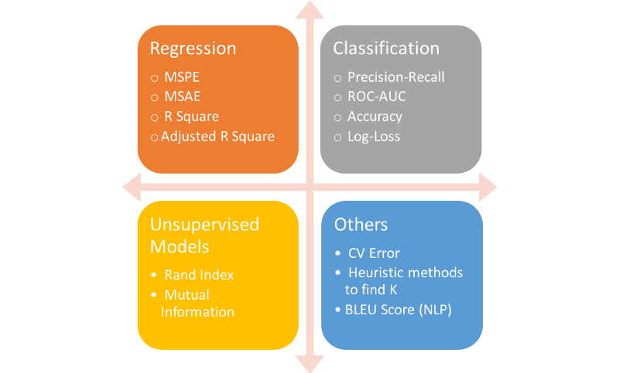
Performance Evaluation Metrics

Slide 4
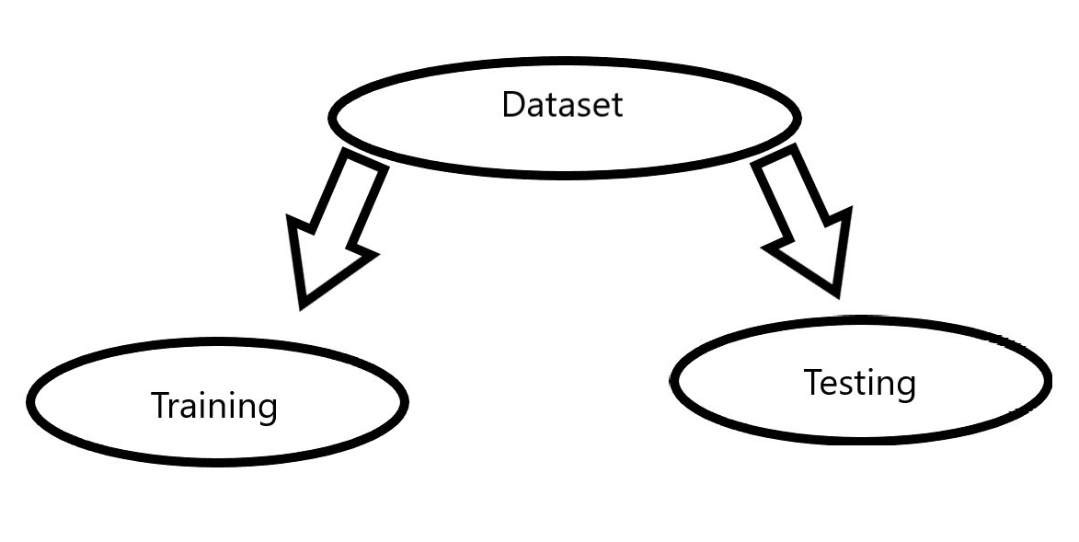
Data Splitting
Refers to splitting the datasets in two parts i.e. training dataset and test dataset
It also helps in the evaluation of deep learning models
Keras provides two efficient methods
for model evaluation
Using an automatic verification dataset
Using a manual verification data

Slide 5
Automatic Verification Dataset
Automatically separate some portion of training data into a validation dataset
Evaluate performance on the separated validation set
Done using validation_split argument on the fit() function to a percentage of your training dataset’s size.

Slide 6
Manual Verification Dataset
Manual specification of dataset for validation
Can separate dataset in training and test datasets
Using train_test_split function, where you can specify the percentage of data used for validation and the remaining for training

Slide 7
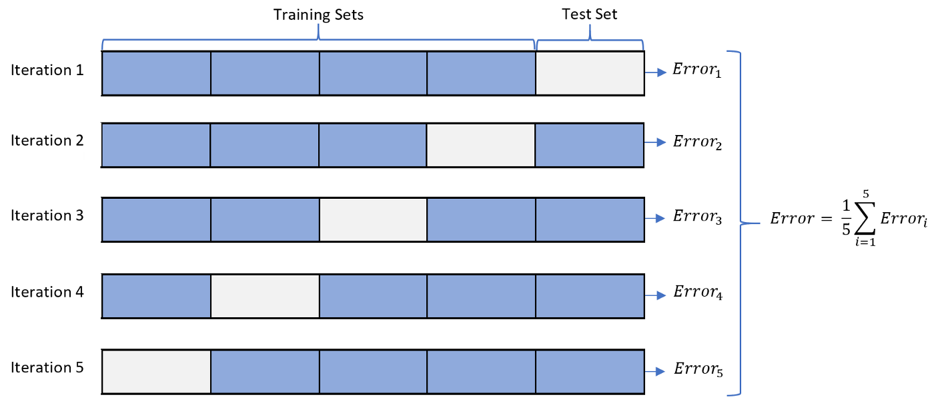
Manual K-Fold Cross Validation
Powerful estimate on the model’s performance evaluation
Done in a number of iterations
The training dataset is split into k subsets, training models on all subsets one-by-one except one.
Repeat the process until all subsets have got the opportunity to be held-out for validation
Then take the average of all
models created

Slide 8
Cons of Cross Validation
Requires greater computational power
Often used with 5 or 10 folds, so 5 or 10 models must be created and evaluated
Greater time

